Slide 1


Improving Reinforcement Learning-based Autonomous Agents with Causal Models
Giovanni Briglia¹, Marco Lippi², Stefano Mariani¹ and Franco Zambonelli¹
¹ University of Modena and Reggio Emilia
² University of Firenze
PRIMA 2024
The 25th International Conference on Principles and Practice of Multi-Agent Systems
Kyoto | November 21, 2024

Slide 2
Motivations & Goals
Context: RL is an established technique to build autonomous agents
Problem: Training RL is complex
duration → time
demanding → resources
especially due the needed of exhaustive exploration → inefficiency
Our contribution: Can causal reasoning improve RL?

Slide 3

Background – Reinforcement Learning (RL)
Hint: Learning from experience
Pros: Adaptability and cutting-edge applications
Cons: Long training times, unsafe exploration, poor transferability
Ineffective exploration can lead to dangerous states (e.g. game over) and missing rewards

Slide 4
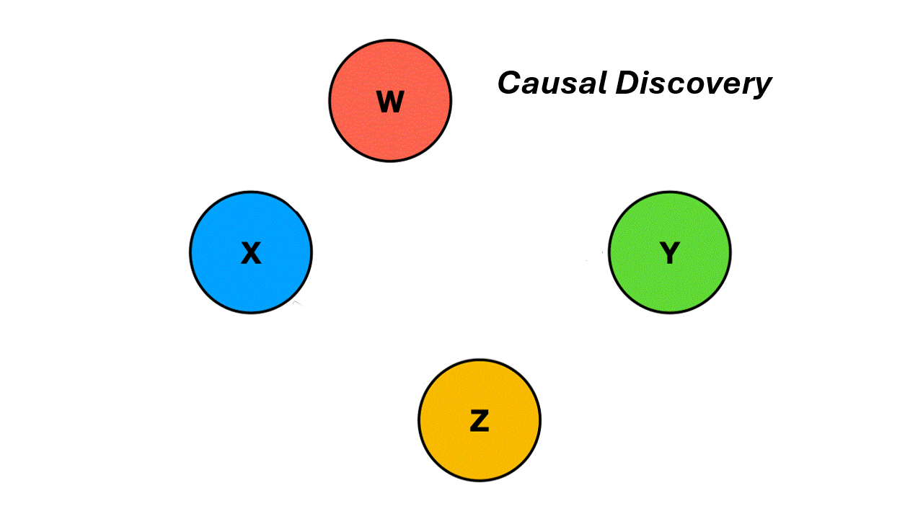
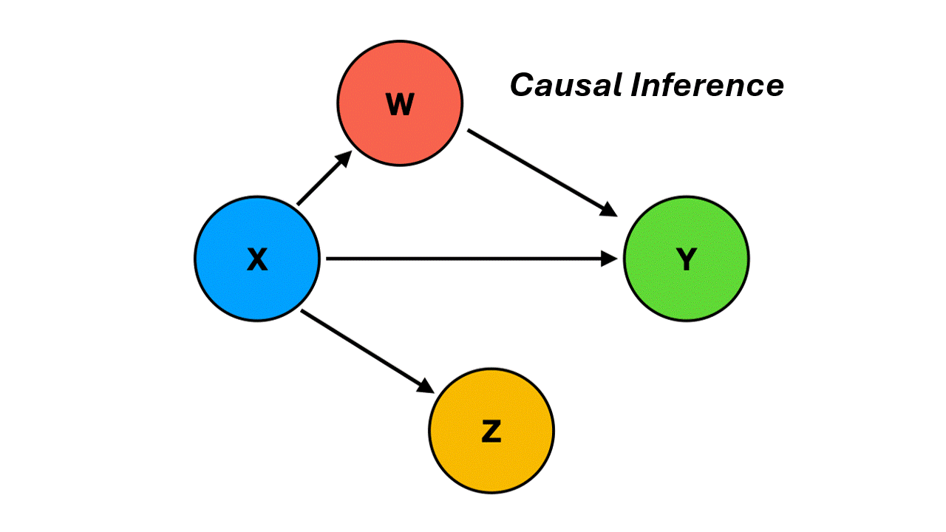
Background – Causal Models
Pearl’s Framework & Structural Causal Models:
Qualitative: Directed Acyclic Graph (DAG) → cause-effect relations
Quantitative: Structural Equation Models (SEMs) → influence quantifications
Causal Discovery (Learning) and Causal Inference (Exploiting)
Causal Reasoning in RL → from correlation to causation
→ agent-environment relationship representation

Slide 5
Research Questions (RQ#)
Can causal reasoning improve the learning process of vanilla RL algorithms?
Is the answer to #1 positive regardless of the exploration strategies?
Is there any performance difference between the offline and online modes?
offline = prior to RL
online = in parallel with RL
Can CDRL improve RL generalisation to unseen environments?

Slide 6
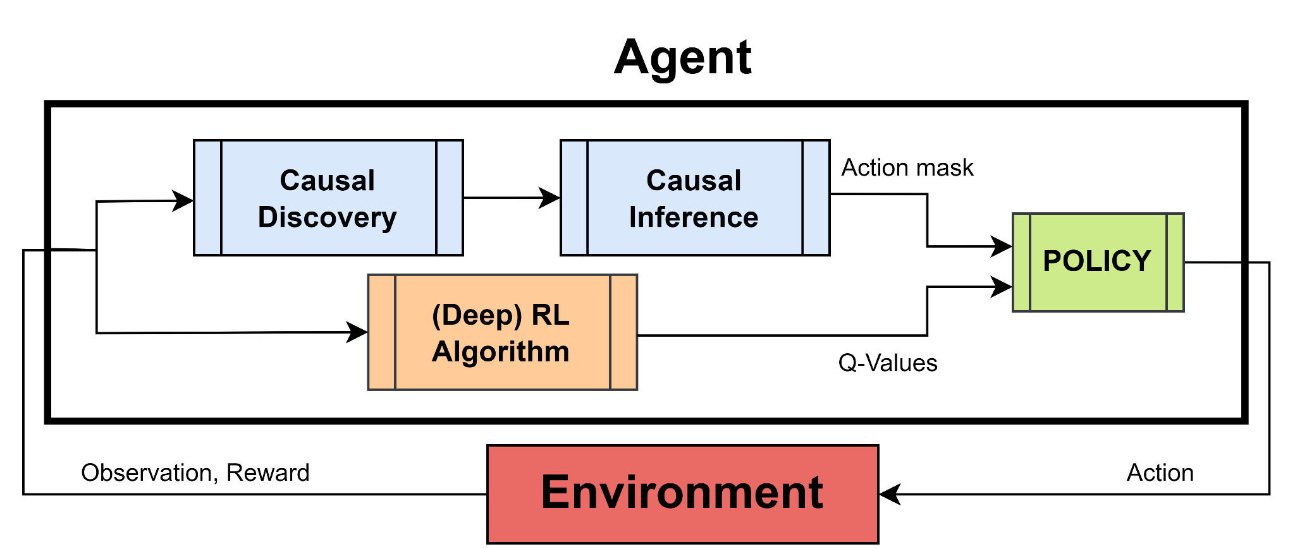
Causality-Driven RL Framework
How: Understand (predict) how actions (cause) may change the state of the environment (effect), and, in turn, how to plan actions to achieve a desired state.
Causality as action
space filter
Pluggabile into any
(deep) RL algorithm

Slide 7
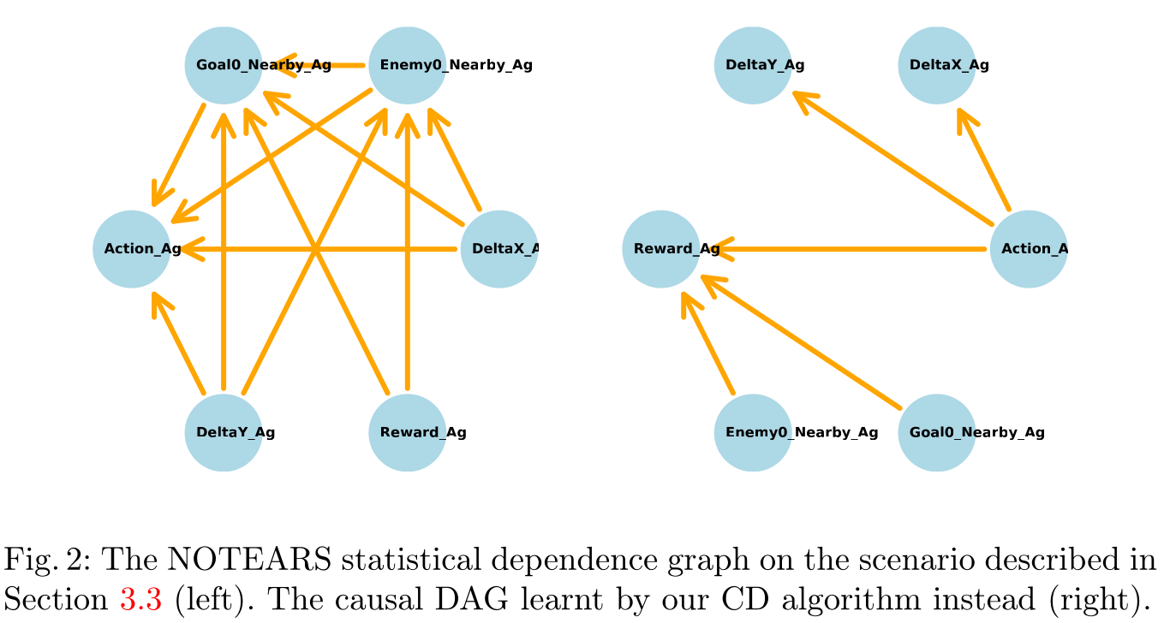
Causal Discovery
Causal Discovery
Learn causal graph based on state-action-reward trajectories
Core-Environment Dynamics
In RL, can be considered as the set of features that directly influence the target feature (e.g., the reward).
In causal reasoning, once the target feature is specified (analogous to RL), the concept is close to the Markov Blanket.

Slide 8
2) Causal inference
At each decision point, given the causal graph:
Condition the observation space variable
Intervene on action variable to evaluate which actions are catastrophic and which are preferable
Constrain the action space
Return constrained actions space
RL Stages:
Exploration: take random action from the pruned exploration space
Exploitation: take greedy action from the pruned exploration space

Slide 9
Clarification:
Offline vs. Online Causal Discovery
Offline: causal model reasoned from a simple version of the environment: Grid 4x4, 1 agent, 1 enemy, 1 goal. No updates.
Online: causal model starts from empty knowledge, the model is learnt and updated in parallel with the RL algorithms. Technicality:
causal convergence → 3 times the same DAG
causal update batch → sensitive analysis: 250 episodes

Slide 10
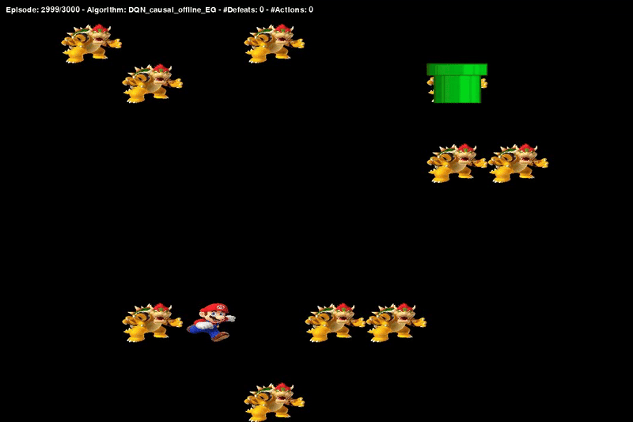
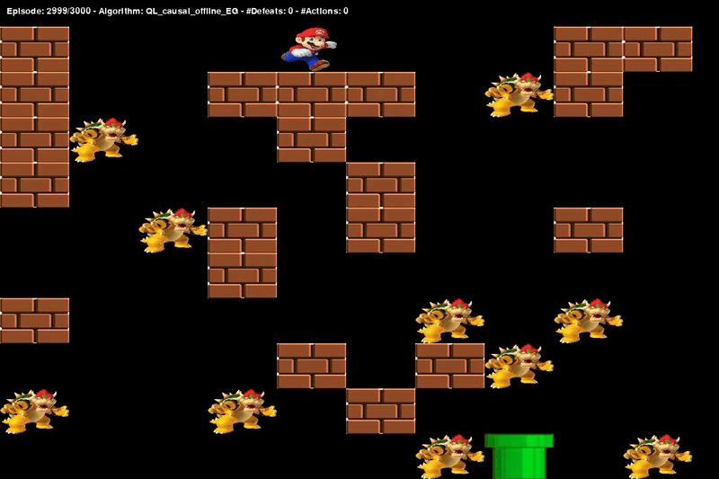
Case Study - Environment
Custom environment: Super Mario vs. Bowsers
Sparse reward scheme: -1: lose | +1: win | 0: otherwise
Partially Observable Markov Decision Process (POMDP)

Slide 11
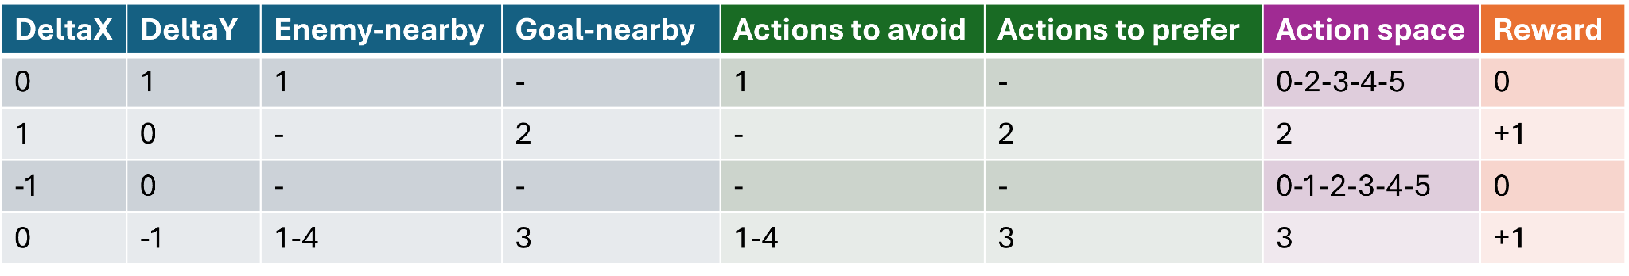
Case Study: Causal Inference
Constrained
Action Space
Observation
Actions Masks

Slide 12
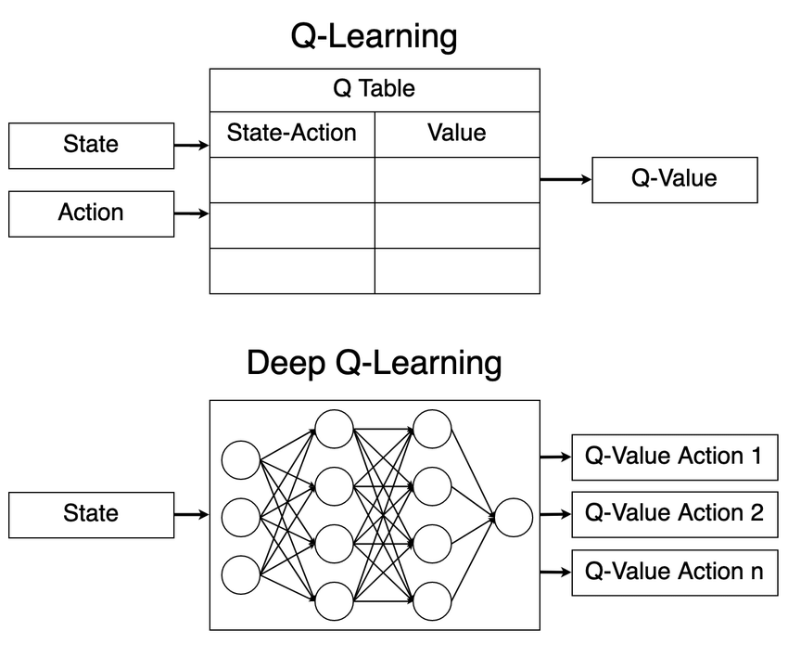
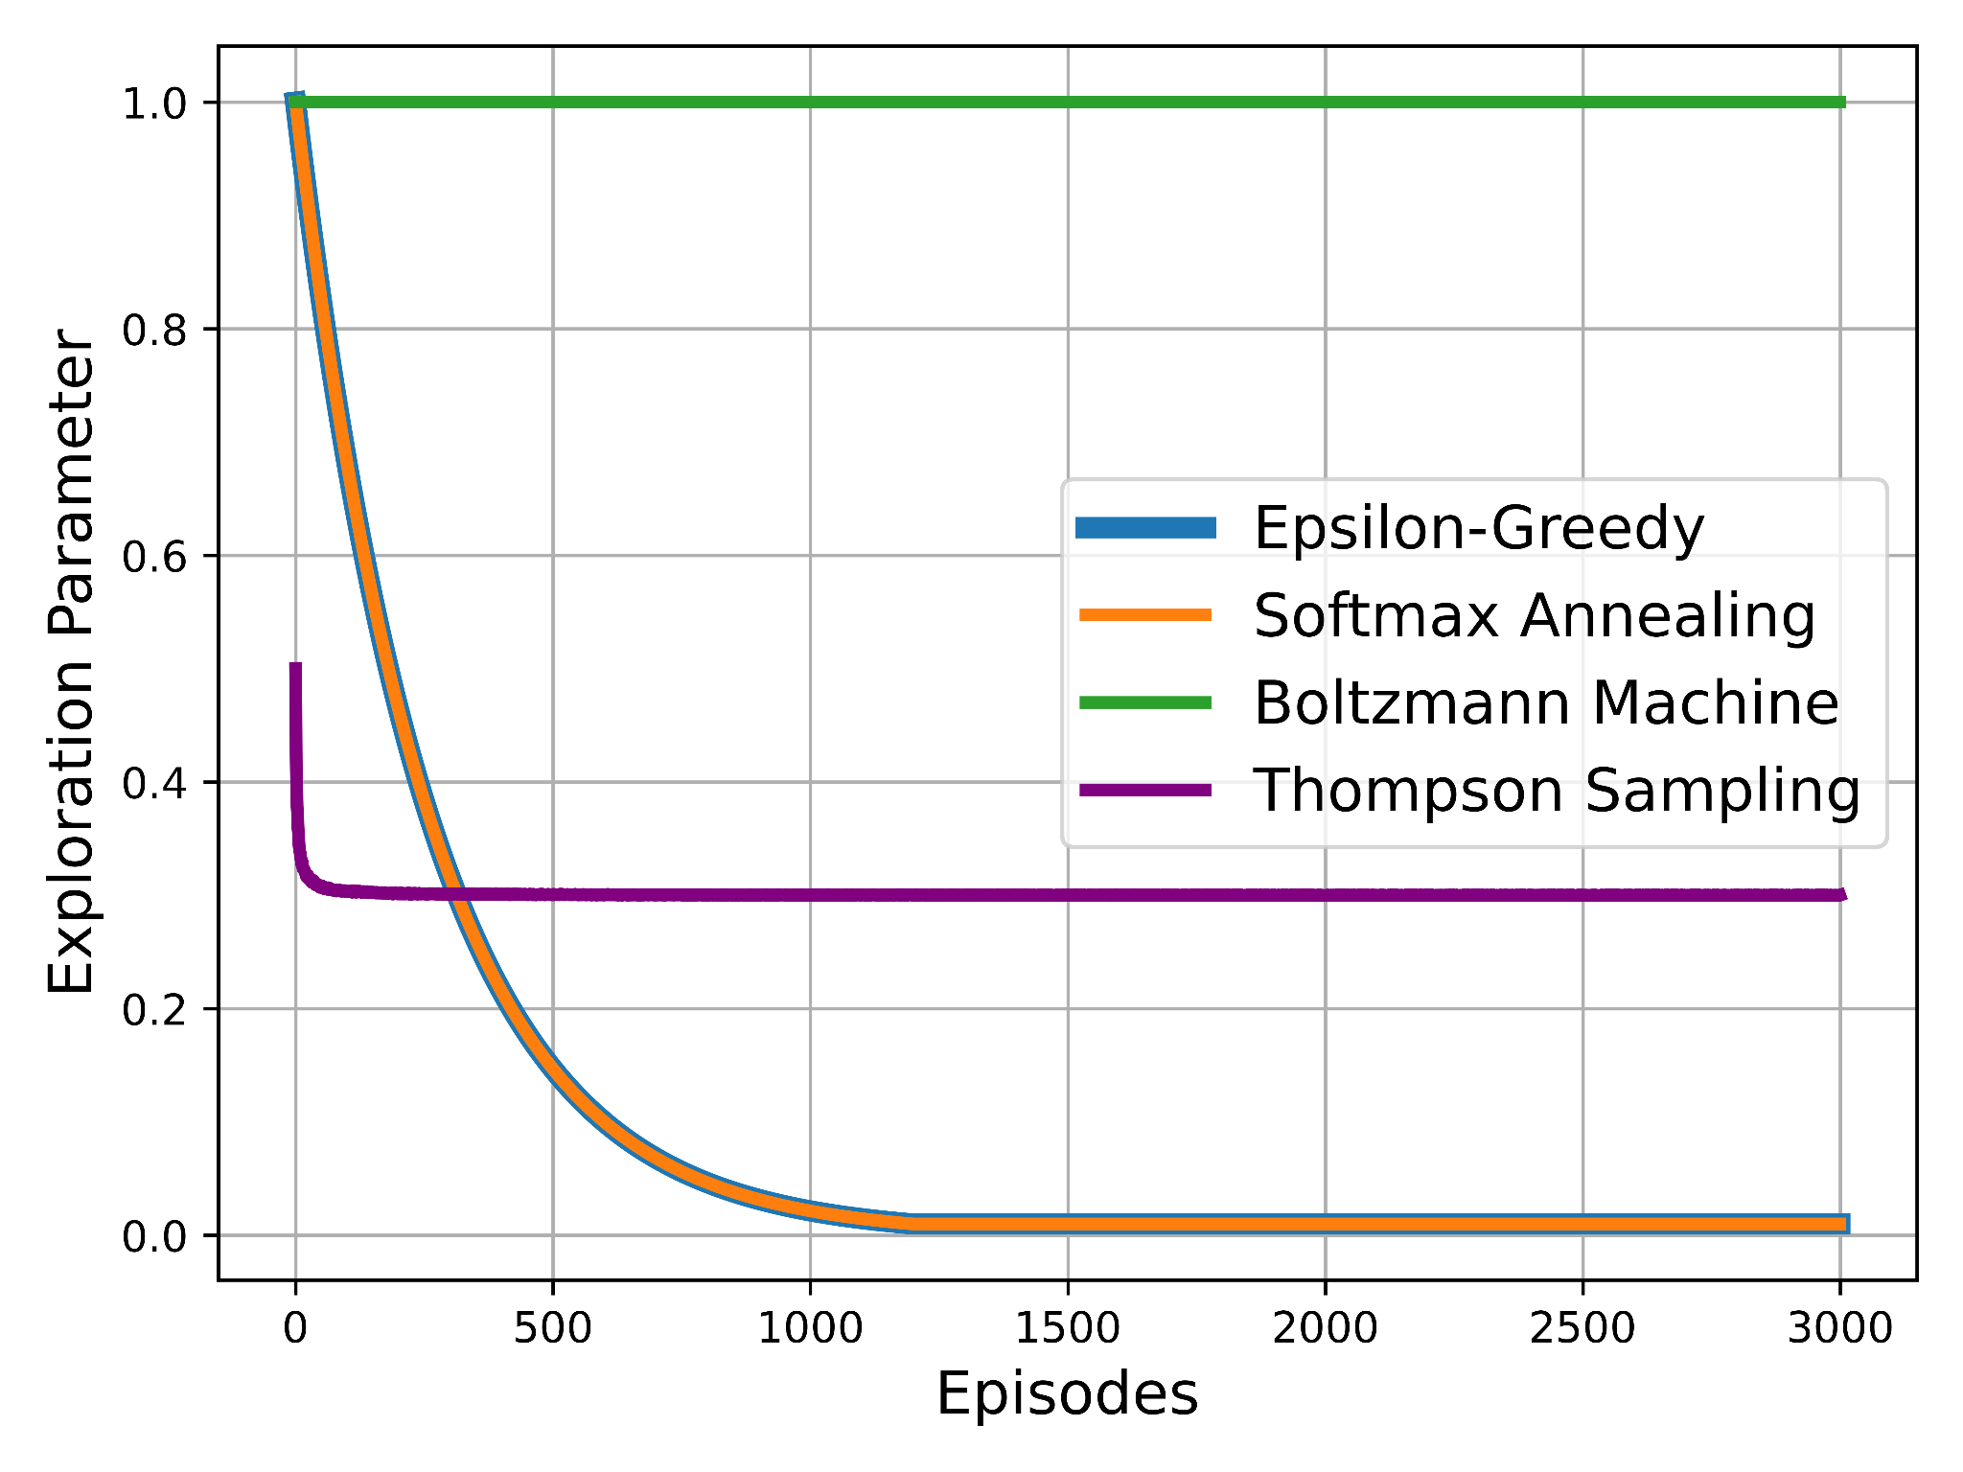
Case of Study: Evaluation
Algorithms:
Q-Learning
Deep Q-Networks
Exploration Strategies:
Epsilon-Greedy (EG)
Softmax Annealing (SA)
Boltzmann Machine (BM)
Thompson Sampling (TS)

Slide 13
Evaluation Setup - Technicality
Results are averaged over 10 games (seeds)
Every single game is randomly generated (same game for each seed)
Metrics (in terms of IQM):
episodic reward: max = +1
cumulative reward: max = #episodes
#actions to complete episode
Further details regarding parameters, hyper-parameters and more can be found in the paper.

Slide 14
Case Study - Experiments
To answer RQ1-RQ2-RQ3
To answer RQ4
Type | Causal Discovery | Exploration Strategy | Environment size | #Enemies
Grid | Offline, Online | EG, TS, SA, BM | 5x5 | 2, 5
 | Offline, Online | EG, TS, SA, BM | 10x10 | 2, 5, 10
Type | Transfer Learning | Causal Discovery | Exploration Strategy | Environment size | #Enemies
Maze | Yes, No | Offline, Online | EG | 5x5 | 2, 5
 | Yes, No | Offline, Online | EG | 10x10 | 2, 5, 10

Slide 15
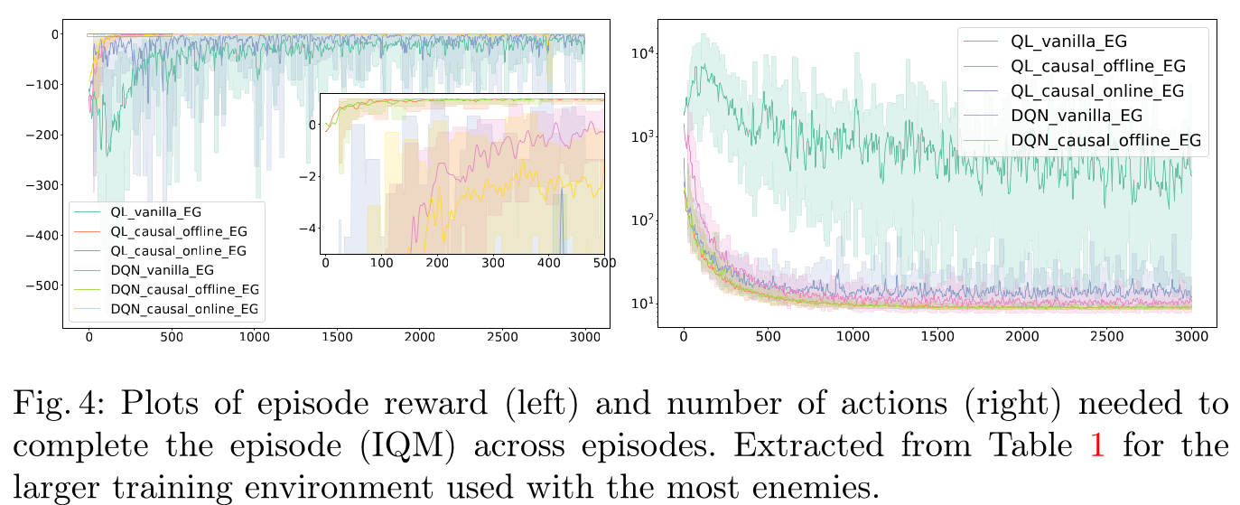
RQ1) CDRL vs. Vanilla RL
The causally-augmented agent demonstrates improved efficiency and effectiveness from the very early stages.

Slide 16
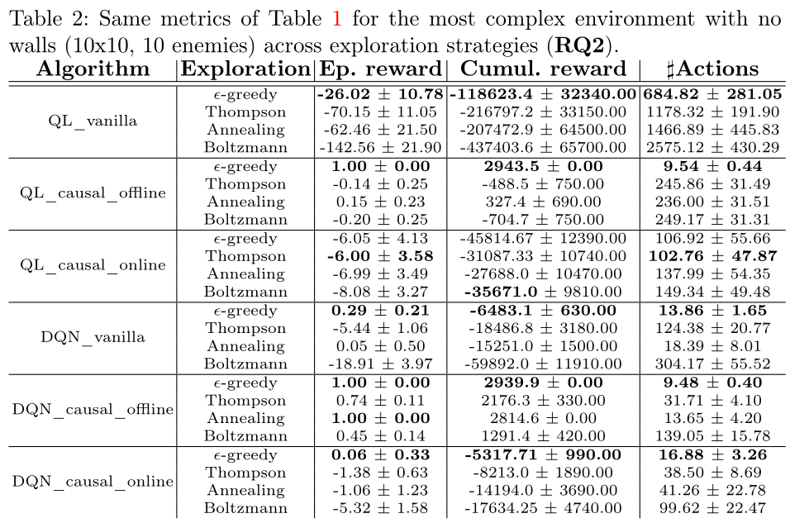
RQ2) CDRL vs. Exploration Strategies
RQ3) Online vs. Offline Causal Discovery
Causal reasoning enhances any exploration strategy.
Offline CD outperforms the Online CD approach in both Q-Learning and DQN.
Notes:
causal reasoning improves RL regardless of exploration strategy

Slide 17
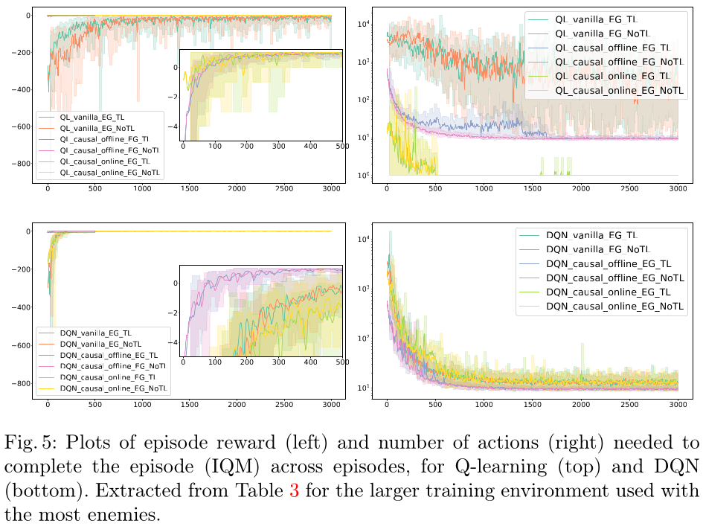
RQ4) Generalisation
Augmented-causal agents perform similarly, regardless of whether knowledge is transferred.
Both in Q-Learning and DQN

Slide 18
Conclusions
TL;DR: CDRL beats RL in performances and generalisation capabilities.
We propose to augment RL agents through a causal model of core-environment dynamics, employed to prune the exploration space. Peculiarities:
Improves the learning process both in efficacy and efficiency
Improves the generalisation capabilities
Bonus: Offline Causal Discovery → it avoids re-learning the causal model when the environment changes.

Slide 19

Limitations and
Future Developments
Needed to more generalization tests
Needed to improve the filter-based logic
Handling continuous features in causal reasoning
Formalization of the core-environment dynamics
Continuous Causal Reasoning
Multi-Agent Causal Reasoning

Slide 20
Thanks for the attention
Corresponding author:
Giovanni Briglia - giovanni.briglia@unimore.it

